Slide 1
Master Research Internship
Outlier detection on file server backup data
Presentation
By: Frederic Abraham
Supervisors:
RWTH: Dr. Thomas Eifert
DKE: Prof. Kurt Driessens

Slide 2
Organizations in Higher Education
Large Attack Vector
Many students and Employees
Stranger friendly
Lacking security
44% were attacked
54% succeeded
35% paid the ransom
55% restored their data through backups
, of which
, of which
[1] Adam, Sally. 2021. The State of Ransomware in Education 2021. Technical report.
Notes:
A

Slide 3
Ransomware

Slide 4
Ransomware
Intrusions
Fileservers

Slide 5

Outline
Introduction
Background Information
Problem Statement / Research Question
Outlier Detection
Concepts
Metadata Model
One-class Support Vector machines
Interpretability
Approach
Evaluation
Results
Continues Training
Feature Influences
Discussion
Different Classifications
Future Work
Conclusion

Slide 6
Introduction
Background Information + Problem Statement / Research Question

Slide 7
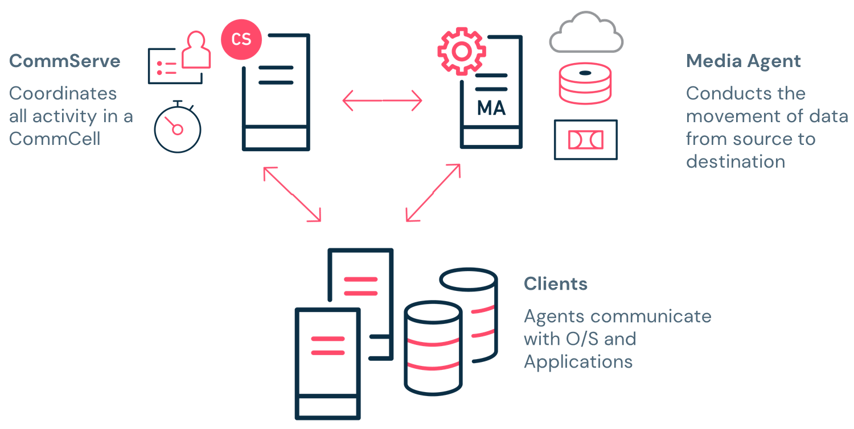
Background Information
CommServe
Coordinates all activity in a CommCell
DaSi.NRW
27 Organisation
3 Service Provider
Commvault Data Management Solution
Media Agent
Conducts the movement of data from source to destination
Clients
Agents communicate
With OS and
Applications
Figure 1: Commvault Overview

Slide 8
Research Question – 1
Incremental Backups
File Server
Regular Mode
Malicious
Activities
Is it possible to detect anomalies in file modification patterns of a file server based on backup log data compared to a learned standard mode?

Slide 9
Research Question – 2
Subjected to change
Continuously learn
Outlier or
new behaviour
Can the model continuously learn gradual changes in regular modification pattern’s to accommodate new users or tasks?

Slide 10
Outlier Detection
Motivation + Research Questions

Slide 11
Outlier Detection
outliers are different from the norm with respect to their features
Deviate significantly
outliers are rare in the dataset compared to the regular instances
Grubbs, Frank E. 1969. “Procedures for Detecting Outlying Observations in Samples.”
Goldstein, Markus, 2016. “A Comparative Evaluation of Unsupervised Anomaly Detection Algorithms for Multivariate Data.”
Supervised
Unsupervised
Semi-Supervised

Slide 12
Outlier Method Classification
Nearest-Neighbour Based
Proximity-based
Approaches
Fundamental Approaches
Clustering
Based
Projection-based
Approaches
Outlier Detection Approaches
Deep Learning
Approaches
Advanced Approaches
Feedback incorporation
Boukerche et al. (2020). “Outlier Detection: Methods, Models, and Classification.”

Slide 13
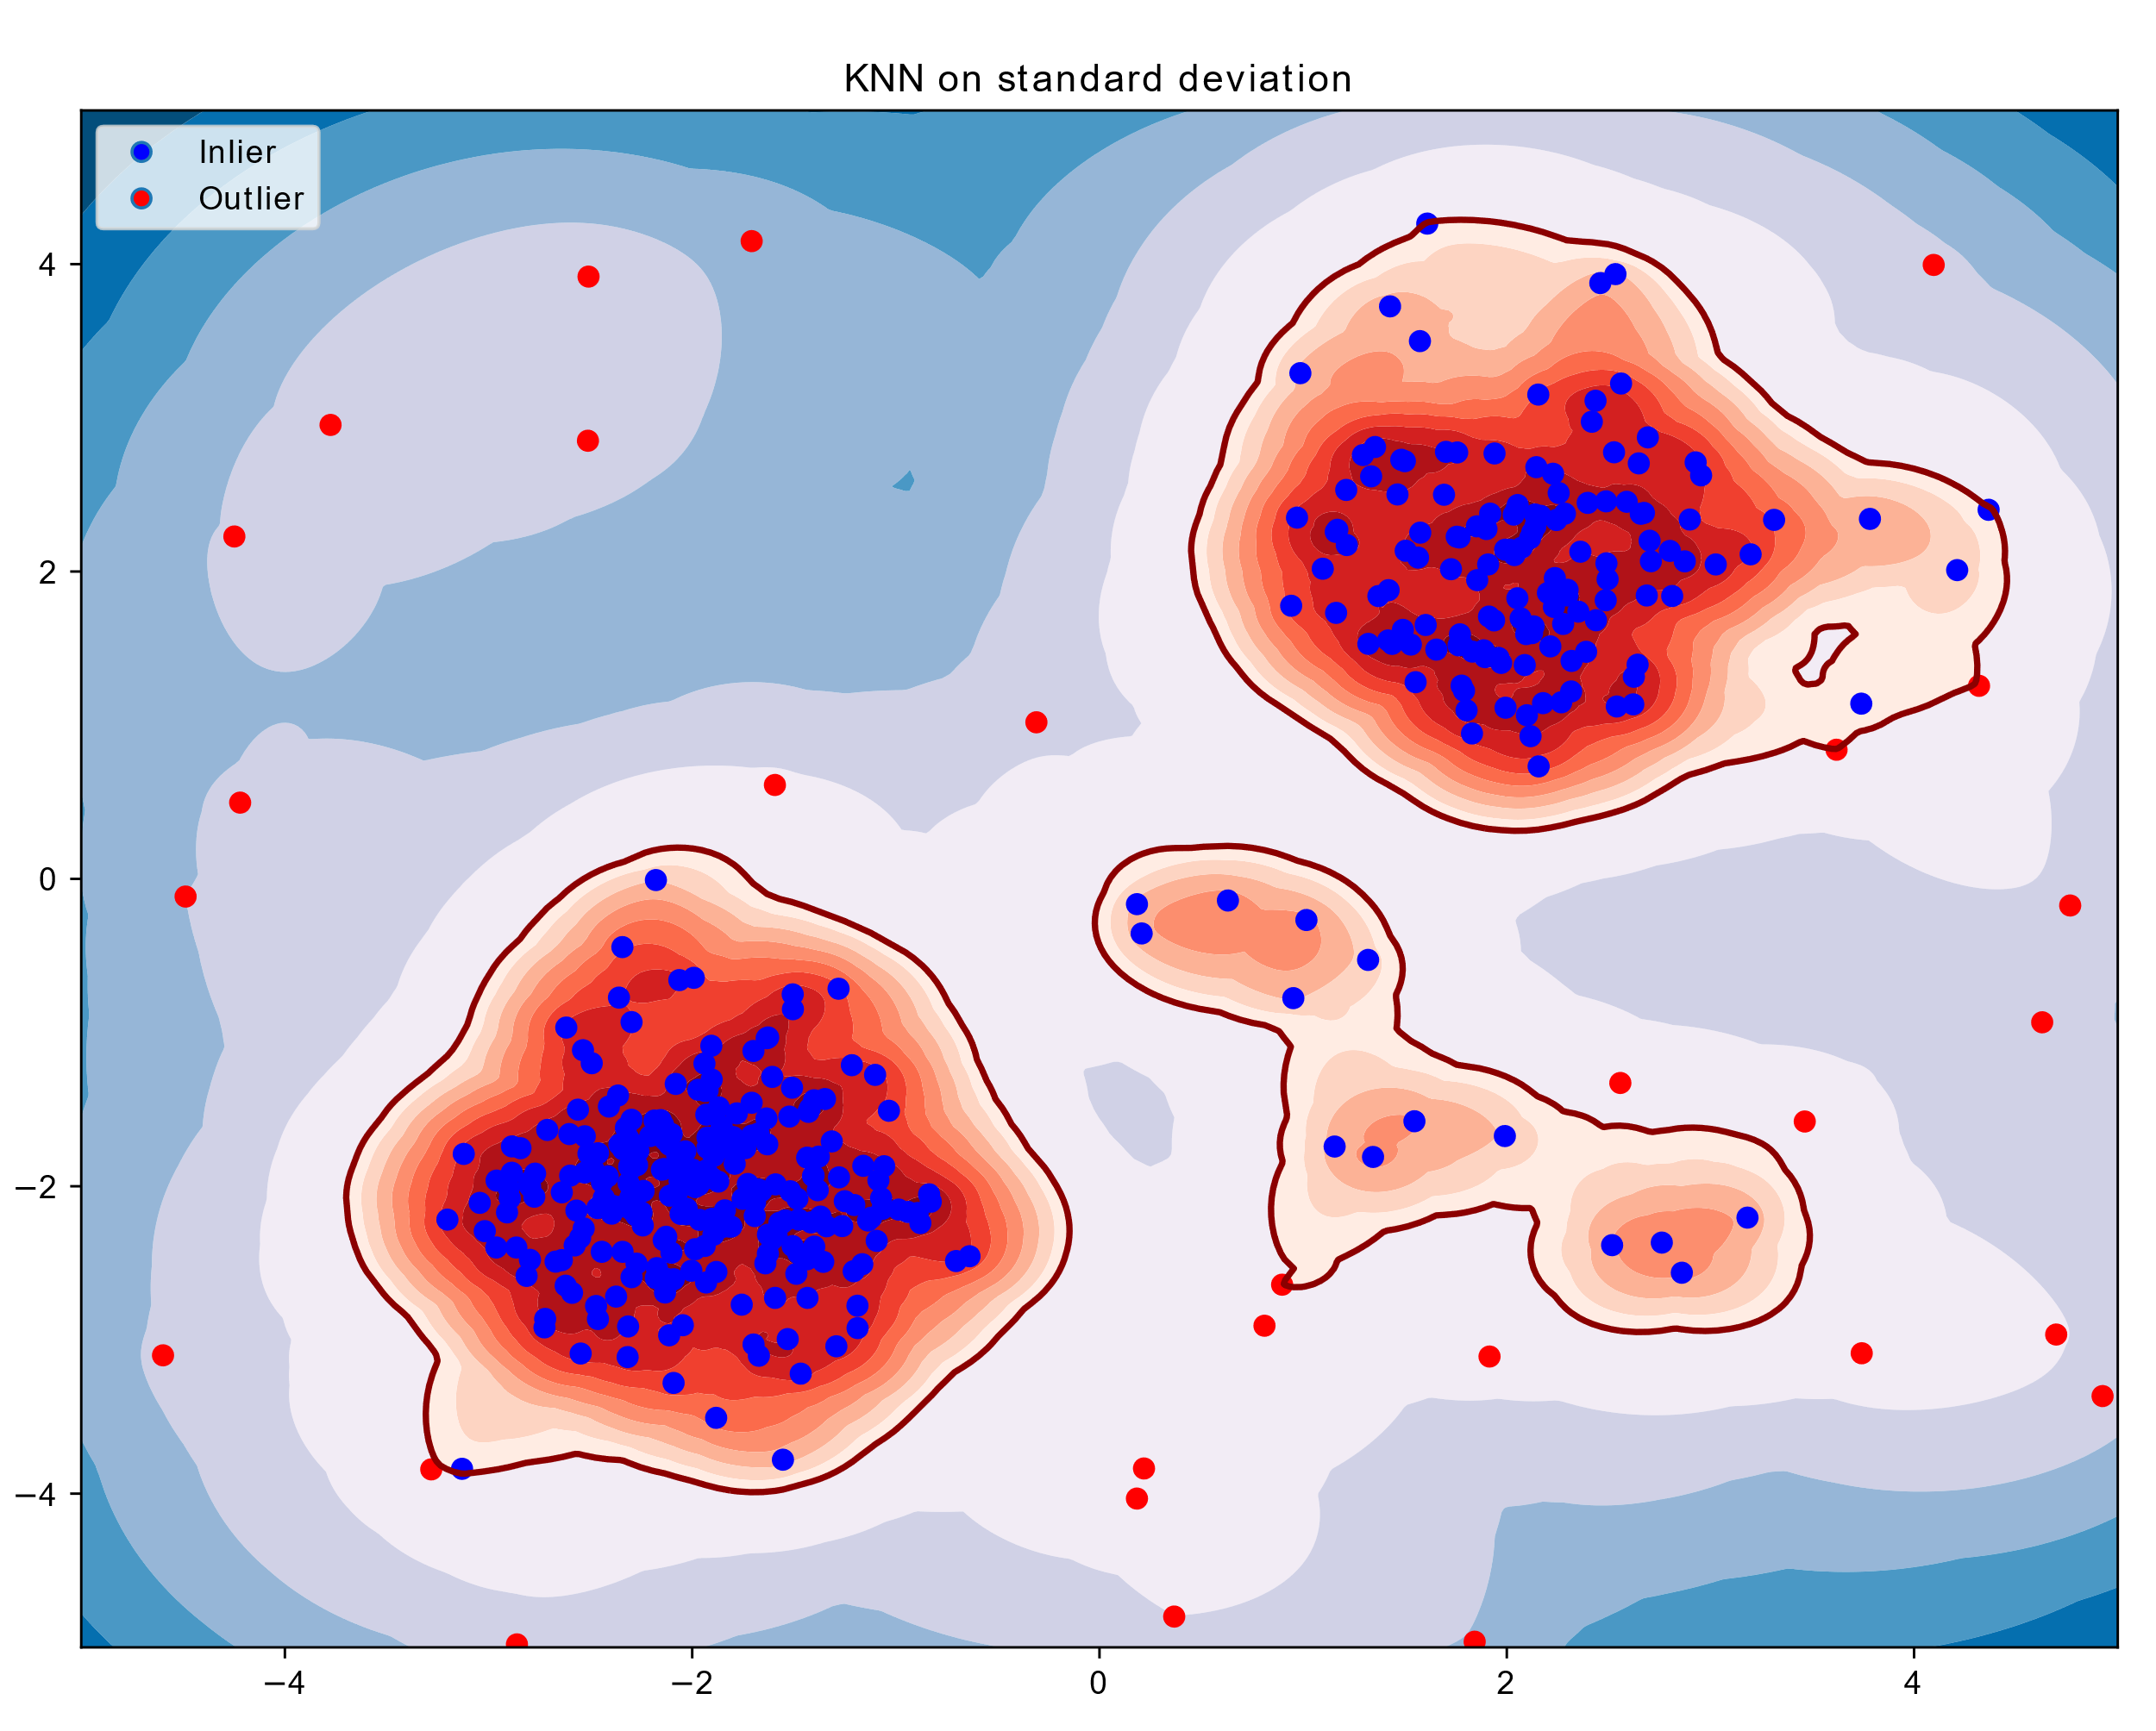
Nearest-Neighbour Based
- KNN
Euclidian Distances
Avg. of K Closest
Create ranking
Select outlier threshold
y
x
Figure 2: KNN on Testdataset
Ramaswamy 2000. “Efficient Algorithms for Mining Outliers from Large Data Sets.”

Slide 14
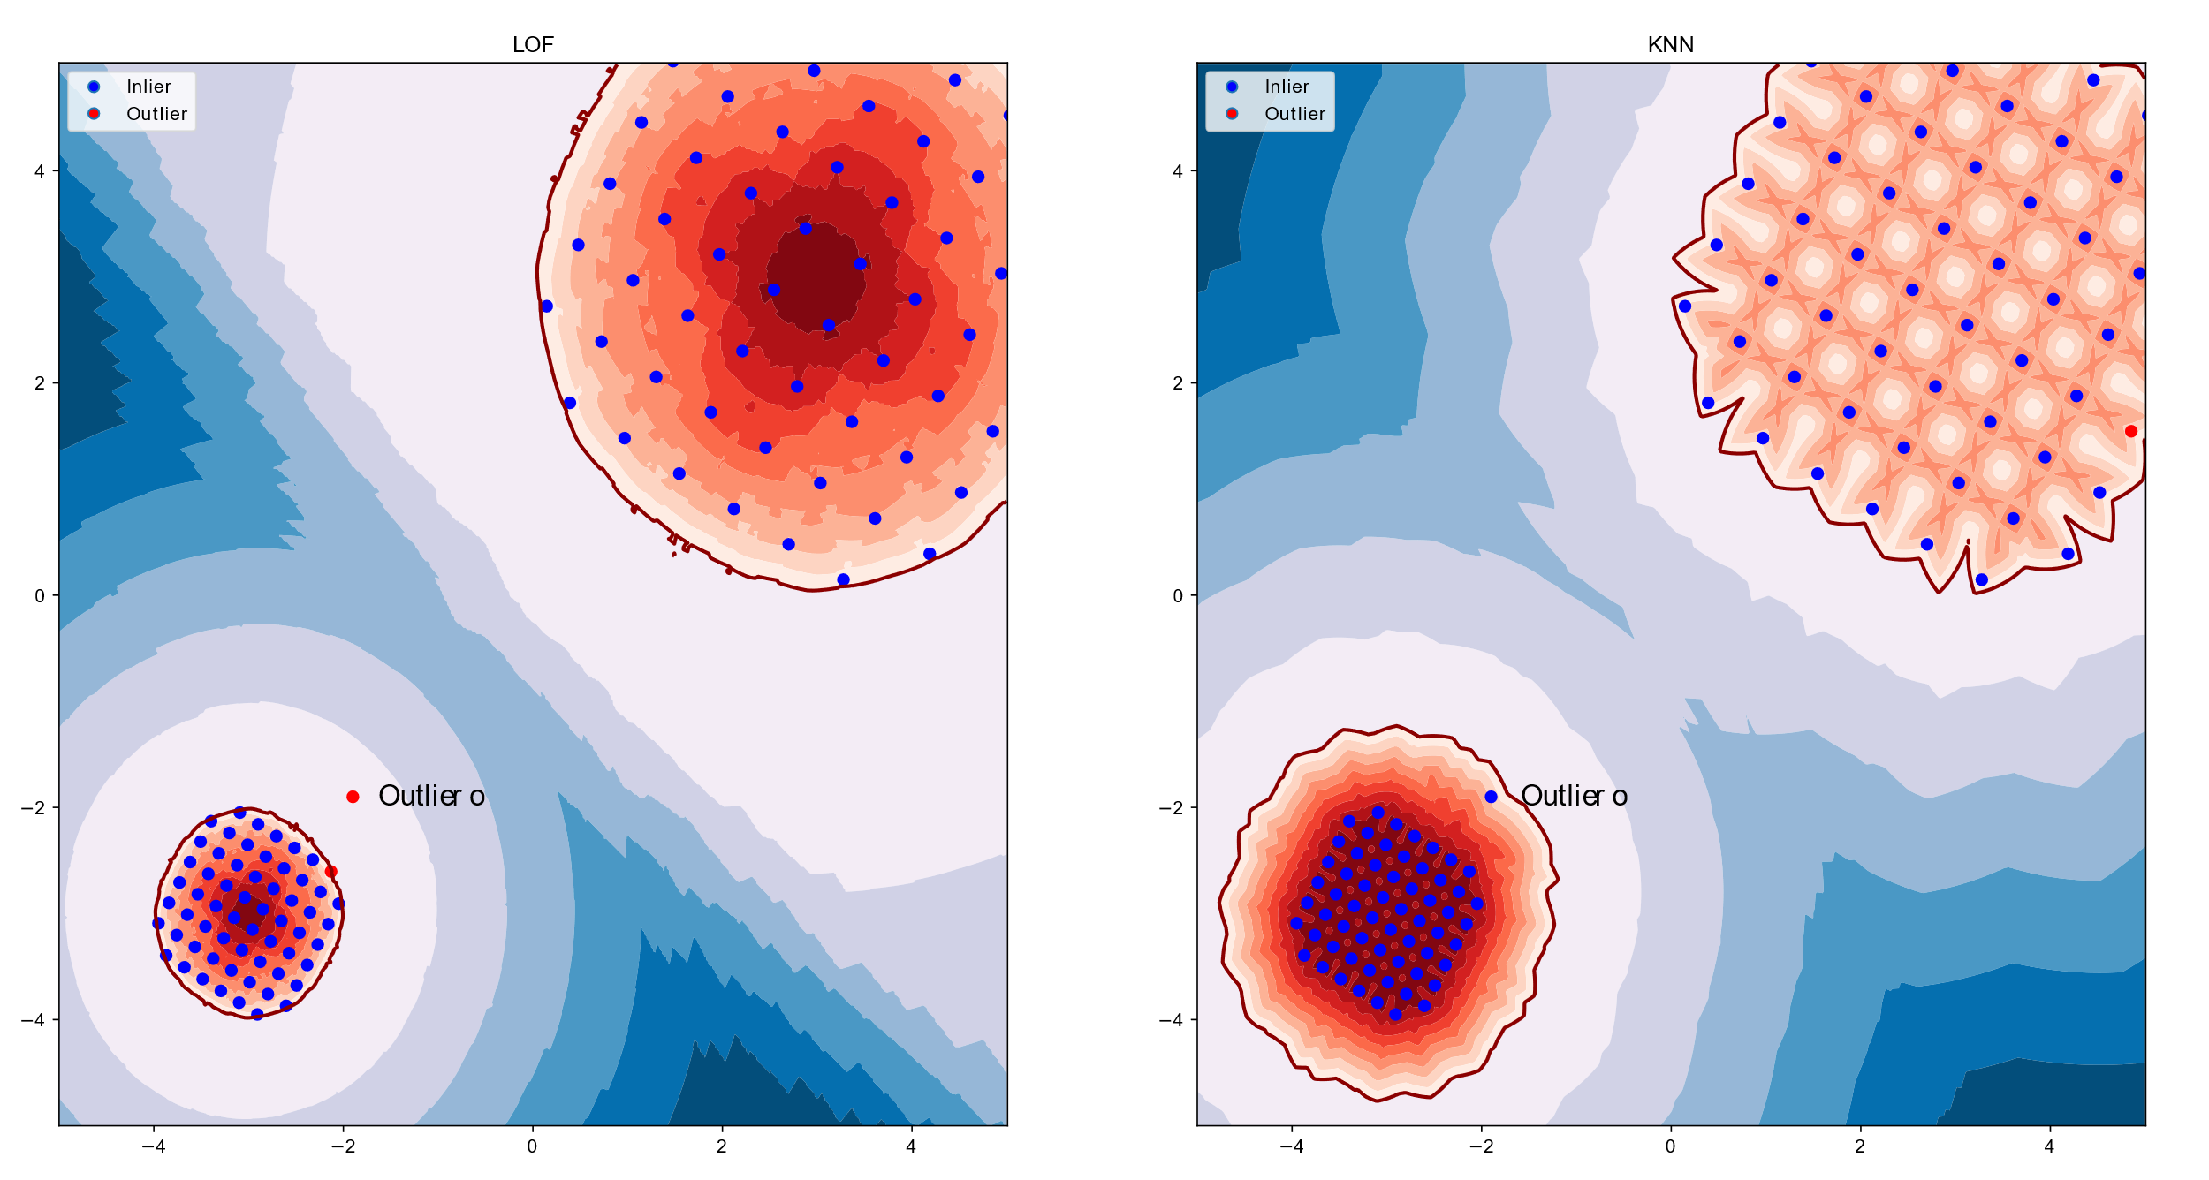
Nearest-Neighbour Based
Figure 3: KNN on Test dataset (Breunig et al. 2000)
Breunig, Markus M. et al. 2000 “LOF: Identifying Density-Based Local Outliers.”

Slide 15
Nearest-Neighbour Based
- Local outlier factor (LOF)
Density calculations
Average Ration of densities
Spherical Distribution Assumption
Figure 4: LOF vs KNN on Testdataset (Breunig et al. 2000)
Breunig, Markus M. et al. 2000 “LOF: Identifying Density-Based Local Outliers.”

Slide 16
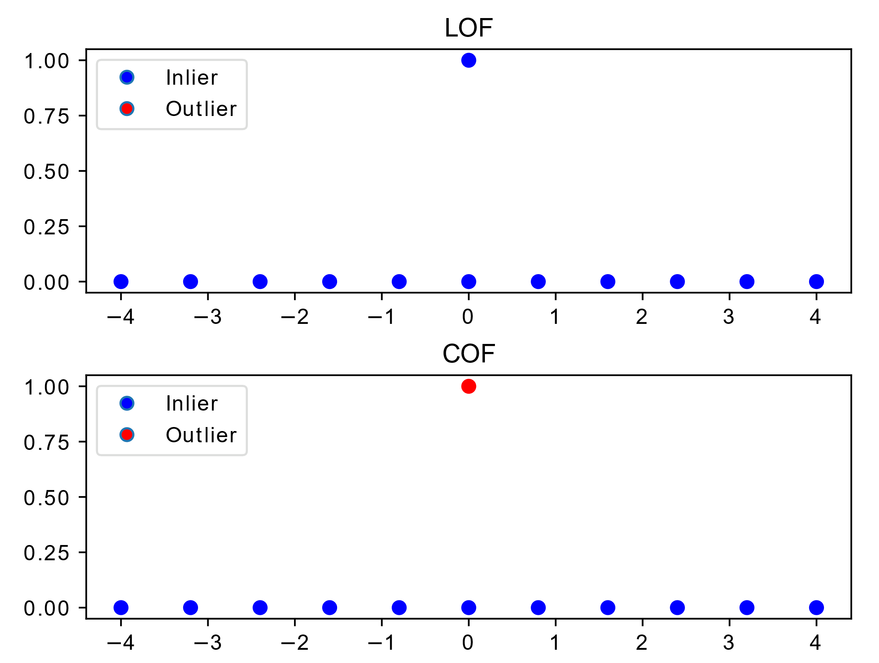
Nearest-Neighbour Based
- Connectivity-based
Figure 5: LOF vs COF
Tang, Jian. et al. 2002 “Enhancing Effectiveness of Outlier Detections for Low Density Patterns.”
Notes:
The comparison of chaining-distances between observation subject to outlier scoring and neighboring observations.

Slide 17
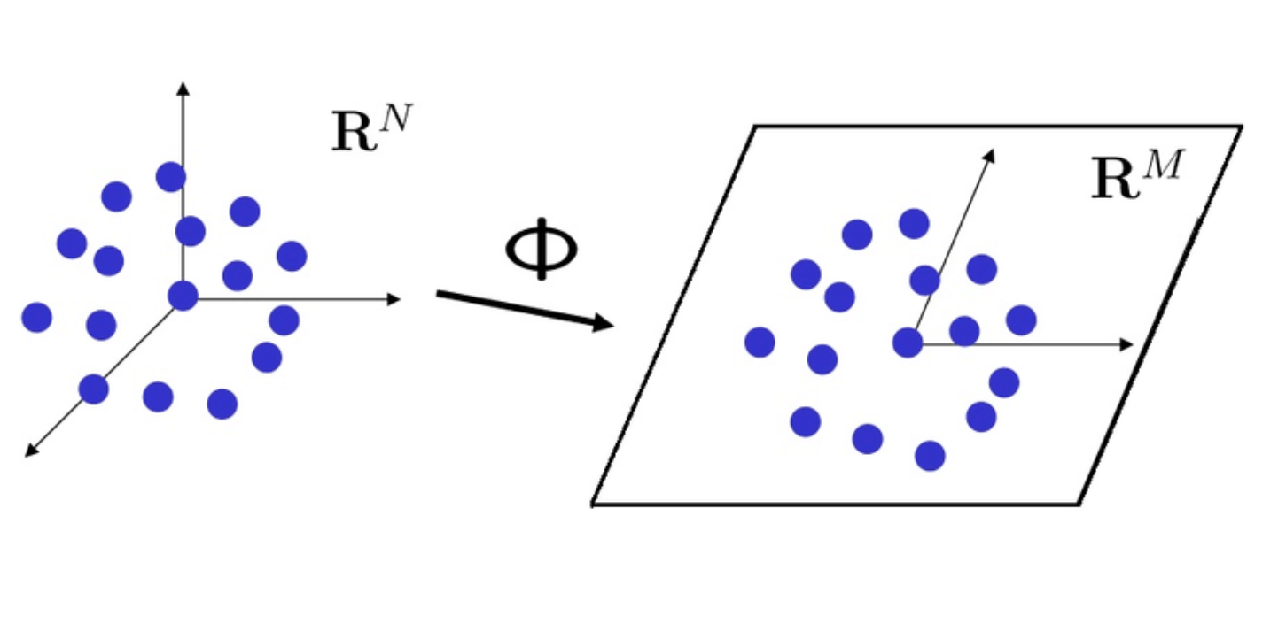
Projection Methods
- PINN
Expensive to calculate Nearest Neighbours
Dimensionality Reduction
Preserve Proximity
Projection indexed Nearest-neighbors
Johnson-Lindenstrauss
LOF
Figure 6: Johnson-Lindenstrauss lemma’s illustration (Source: Fejri 2017)
Vries et al. 2010. “Finding Local Anomalies in Very High Dimensional Space”
Notes:
that a set of points in a high-dimensional space can be embedded into a space of much lower dimension in such a way that distances between the points are nearly preserved.

Slide 18
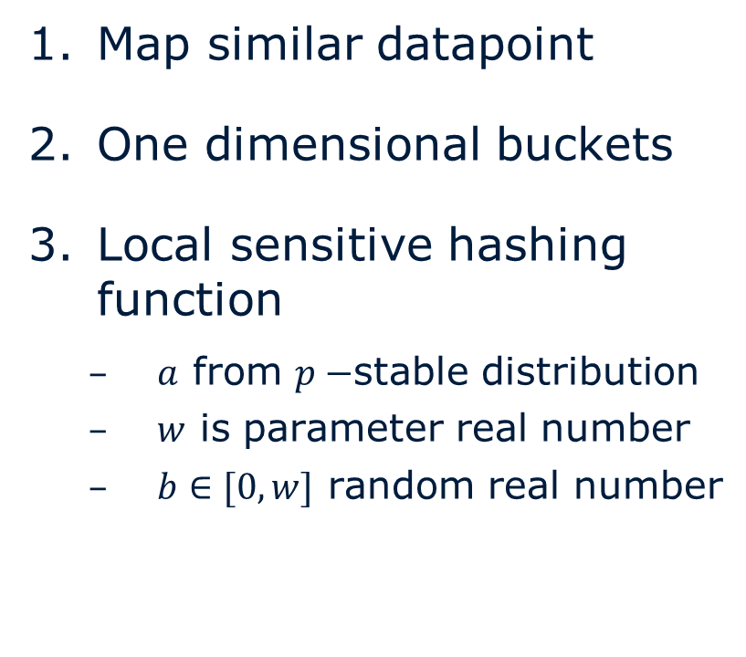
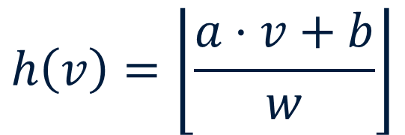
- Bucket Hashing
Projection Methods
Map similar datapoint
One dimensional buckets
Local sensitive hashing function
$a$ from $p−$stable distribution
$w$ is parameter real number
$b∈[0, w]$ random real number
$$h\left(v\right)=\left\lfloor \frac{a⋅v+b}{w}\right\rfloor$$
Equation 1: Locality sensive hasing function
Wang, Ye et al. 2011. “Locality Sensitive Outlier Detection: A ranking driven approach.”

Slide 19
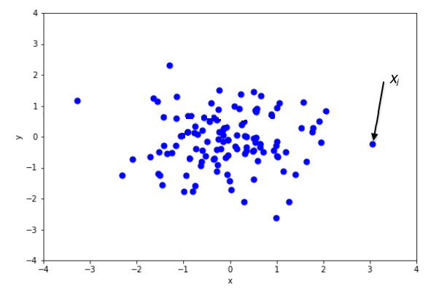
Isolation Forests
Create Trees
Recursively selecting a attribute
A random value
Fewer Cuts
Higher average position
Figure ?: Isolation Forest Algorithm
Liu, Fei Tony, Kai Ting, and Zhi-Hua Zhou. 2009. “Isolation Forest”
Notes:
outliers are easier to separate from the remaining data with fewer cuts

Slide 20
Advanced Approaches
Non-linearity
Deep Learning breakthroughs
Autoencoder (AE)
Generative Adversarial Net’s (GAN)
Reconstructing input at output
Constrained latent space
Reconstruction error
Ensamble, V-AE
Generating new content
Generator, Discriminator
Single-Objective Generative Adversarial Active Learning
Generate Possible Outliers
Hawkins, Simon et al. 2002. “Outlier Detection Using Replicator Neural Networks.”
Liu, Yezheng et al. 2019. “Generative Adversarial Active Learning for Unsupervised Outlier Detection.”

Slide 21
Concepts
SUOD, One-Class Support Vector Machines, Interpretebility

Slide 22
Used Outlier Detection methods
Scalable Unsupervised Outlier Detection (SUOD)
One-class Support Vector Machines (OCSVM)
Feature Vectors
Modular Model ensemble
Problems:
Data Reduction
Slow Model Acceleration
Balanced Parallel Scheduling
Sets of Path Elements
Based on SVM
Separate from Origin
Parameter for Outlier Contamination
Maximise the distance
Zhao, Yue et al. 2021. “SUOD: Accelerating Large-scale Unsupervised Heterogeneous Outlier Detection.”
Schölkopf, Bernhard et al. 2001. “Estimating Support of a High-Dimensional Distribution.”
Notes:
The main idea behind SVM’s is that they separated the two classes by hyperplanes.
Separate all the data points from the origin in the feature space using hyper-plane
Unlike traditional svm where we use soft margin for smoothness, we use a parameter that fixes fraction of outliers in the data
maximise the distance between the hyper-plane and the origin
The points lying below the hyper-plane and closer to origin are outliers

Slide 23

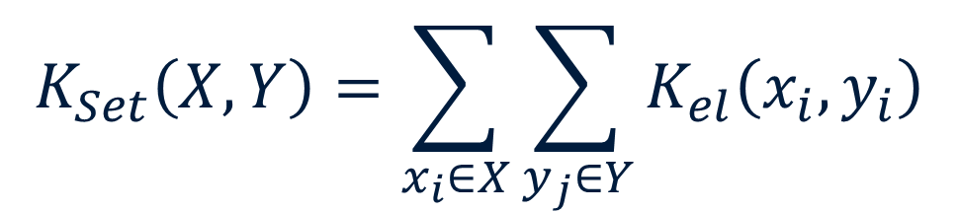
Set Kernel
$$K_{Set}\left(X, Y\right)=\sum_{x_{i}∈X}{\sum_{y_{j}∈Y}{K_{el}\left(x_{i}, y_{i}\right)}}$$
$$K_{el}\left(x_{i}, y_{i}\right)=\left\{\begin{aligned}1, if x=y \\ 0, otherwise\end{aligned}\right.$$

Slide 24
Interpretability

Slide 25
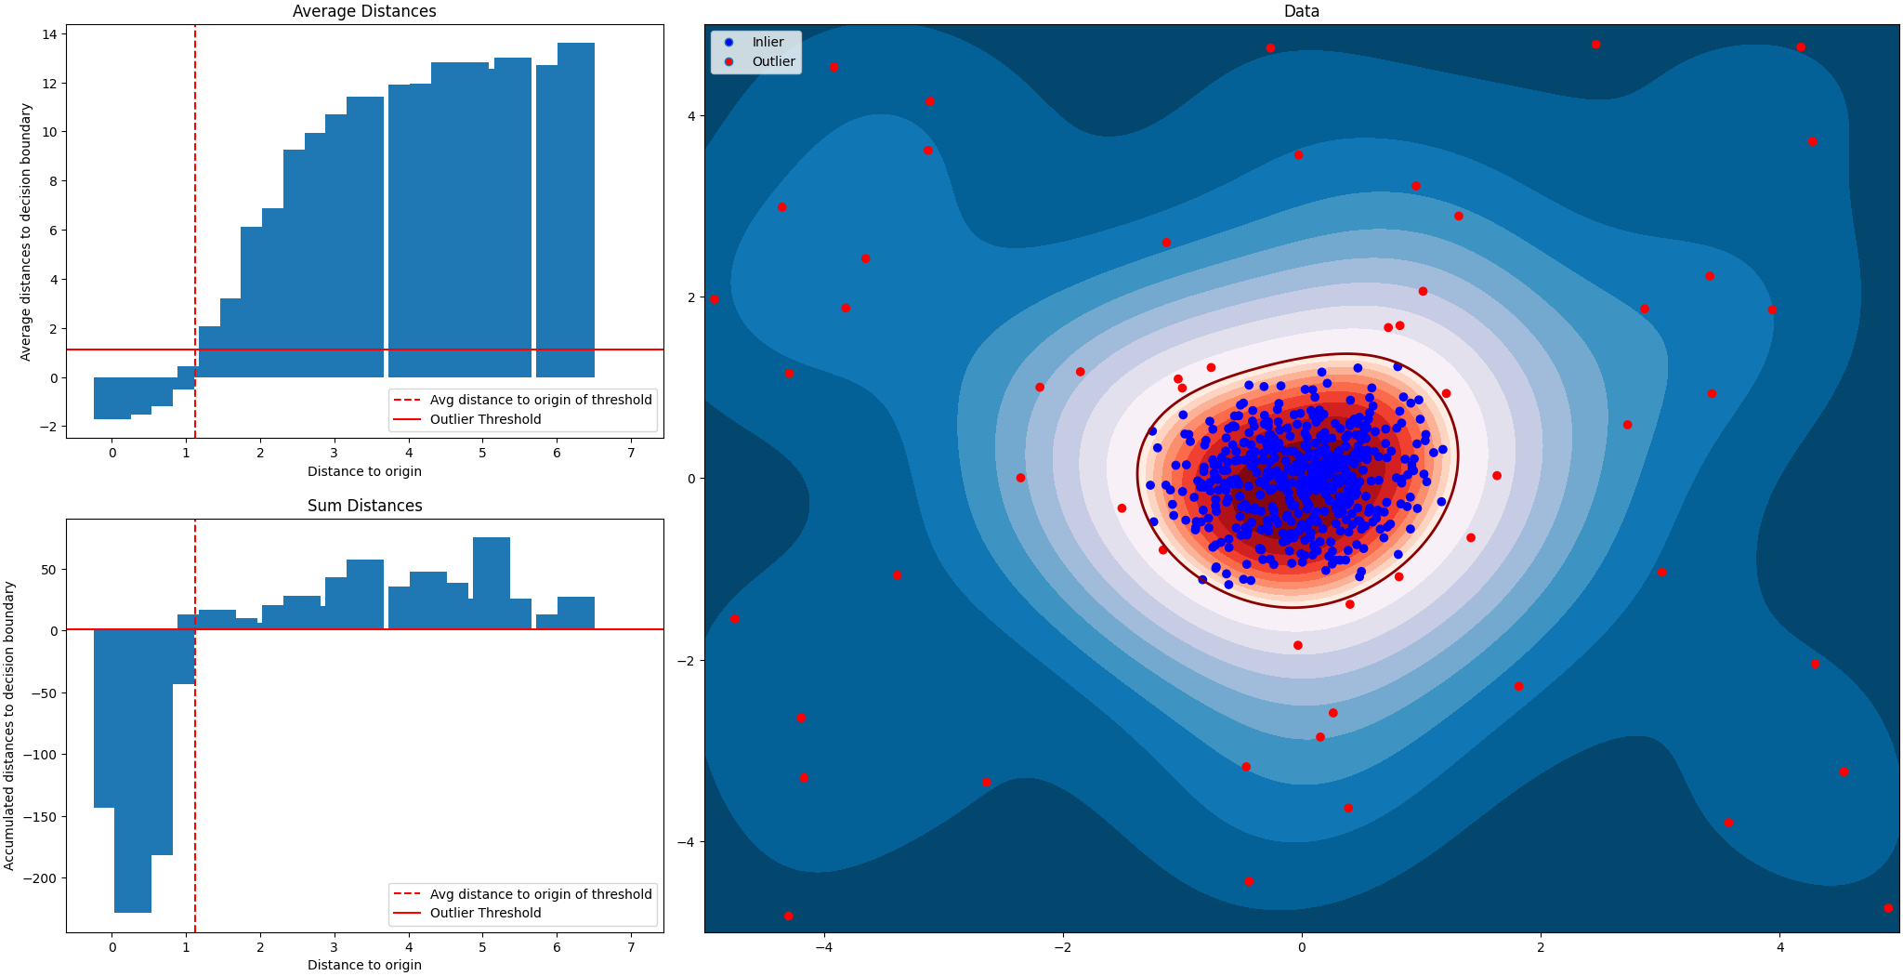
Confidence

Slide 26
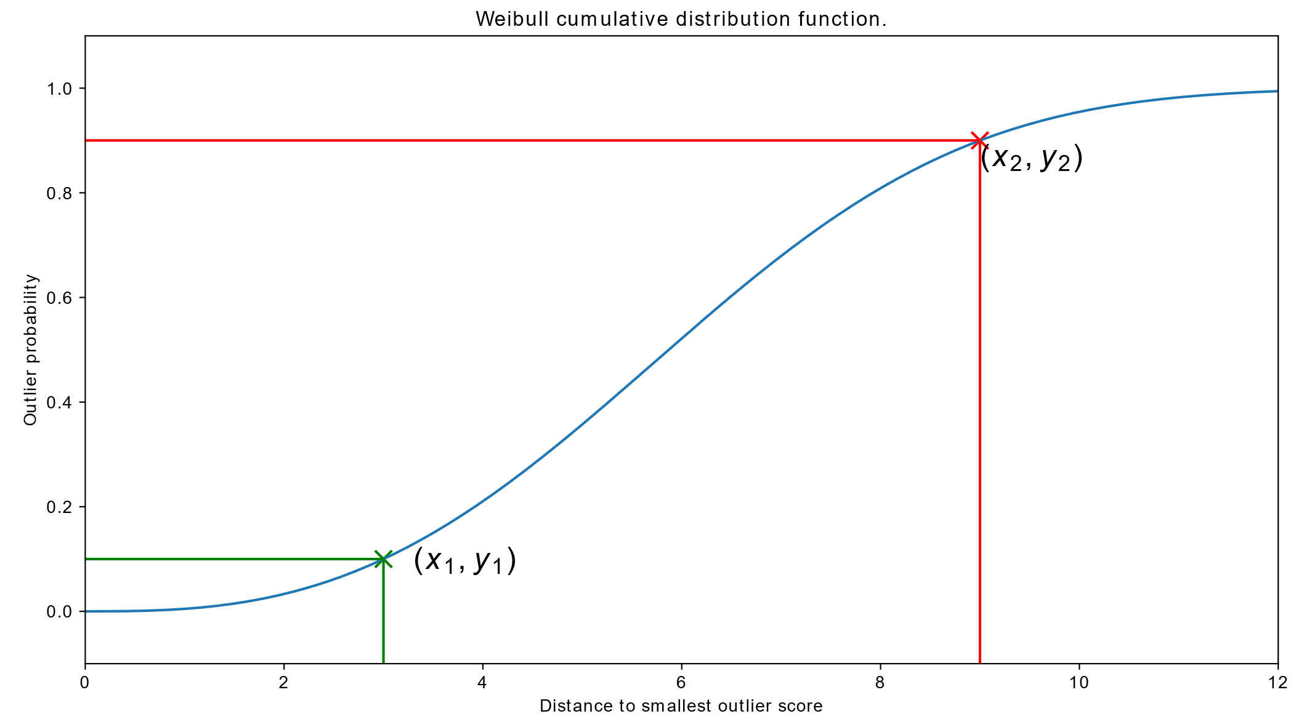
Confidence

Slide 27
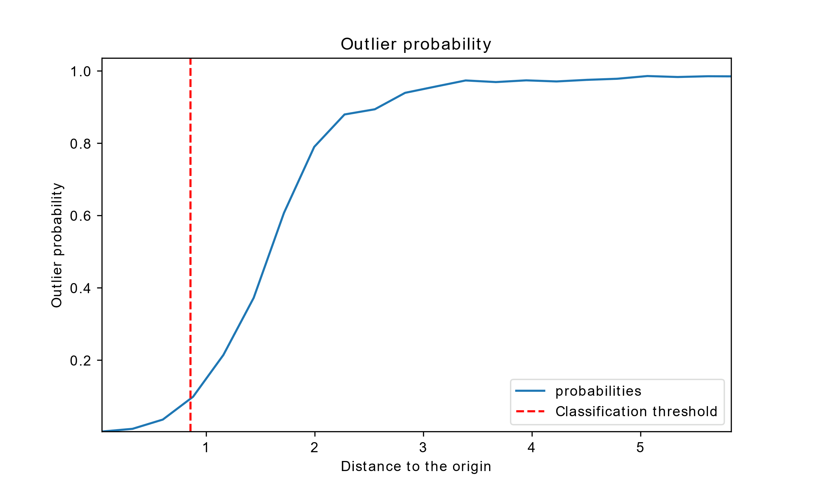
Confidence

Slide 28
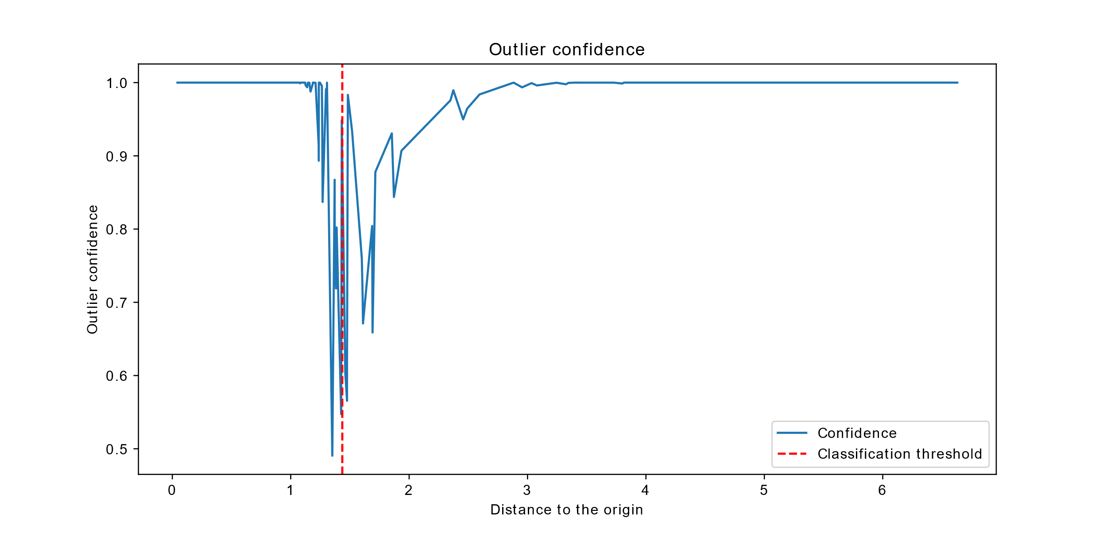
Confidence

Slide 29
Approach
File Server Model + Feature Extraction + Continues Training + Integration

Slide 30
Continues Integration
Action Type
Path
User
Timestamp
Backup Meta Data SUOD
Path Data OCSVM
File Data / History
Extracting generall features over all given properties
Relation with previous and overall data
Comparing to previous metadata
Represent partial file tree over full file tree
Extracting different elements of the path
Comparing backup path data to build file server model
Total change amount
Change frequency
Time since last change
User changes
Predict to user

Slide 31
Continues Integration
Model Initialization
Normal Mode
Initial Backup Set
Extract Features over backup set
Initial Backup Set
Extract Features over backup set
Train Model
Fit scalers and parse features
Train Model
Fit scalers and parse features
Continues Training
Refit Scalers
Add feature Rescale the data
Retrain the used Model
yes
no
Continuously train the model?

Slide 32
General Features #2
Amount
Amount delta
Filetree Features #6
Date Features #5
Path Length (Min, Max, Avg)
Branching Factor (Min, Max, Avg)
Start Time
End Time
Time Range
Time standard deviation
Time Average
Backup
Path
File specific
Dates
Since last backup
Action
Type of actions
User
User of each file
Path Features #5
Different folders
Amount of file endings
Avg Different file endings
File not previously stored
Cross section
Action Features #8
User Features #5
Amount of users
Changed user
File per user (Min, Max, Avg)
Amount for (R, D, M, A)
Delta compared to last backup

Slide 33
Continues Integration

Slide 34
Database Model
Backup Metadata Filetree
Backup Metadata
File Server
File Server Model
_id: UUID
backup_metadata_id
filetree: name
_id: UUID
file_server_id: UUID
backup_date: Number
predictions:
meta_data_model: Dict,
path_ocsvm: Dict
features: Object
action_data:
read: Number
deleated: Number
added: Number
modified: Number
_id: UUID
connection_data: Object
backup_schedule: Number
name: String
responsible: E-Mail
_id: UUID
file_server_id: UUID
path_ocsvm:
svm: Binary
scalar: Binary
gram_matrix: Binary
vocabulary: List of strings
decision_values: Dict
metadata_model:
model: Binary
feature_scalars: Binary
trained_features: List of
Features
decision_values: Dict
file_database: String

Slide 35









Deployment / Integration
Server Environment
Creates Backups
ML-Tool
Fileserver
Fileserver
Fileserver
Vue Frontend
Load Balancer
Classifier
Backend
$$…$$
Fileserver
API
Database
Classifier
Python Module

Slide 36
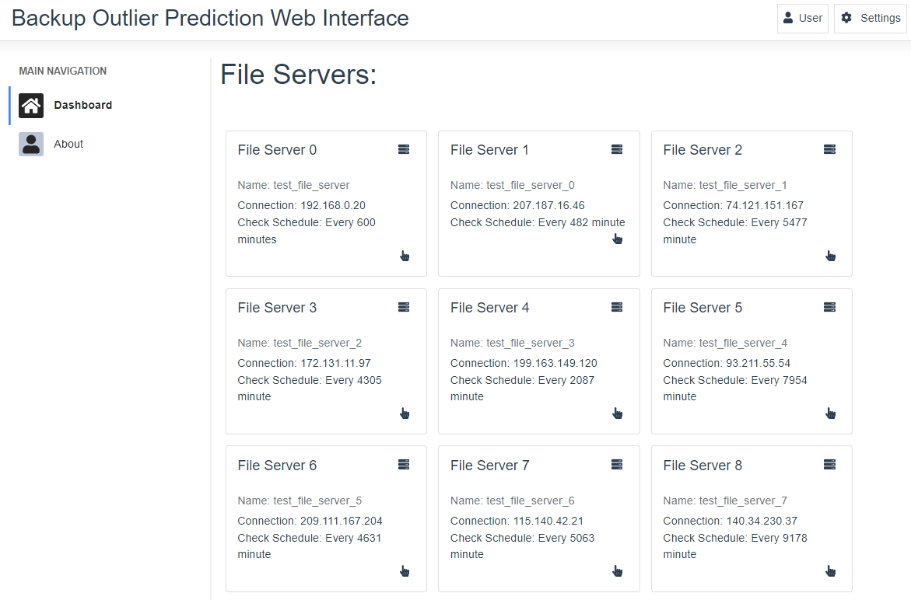
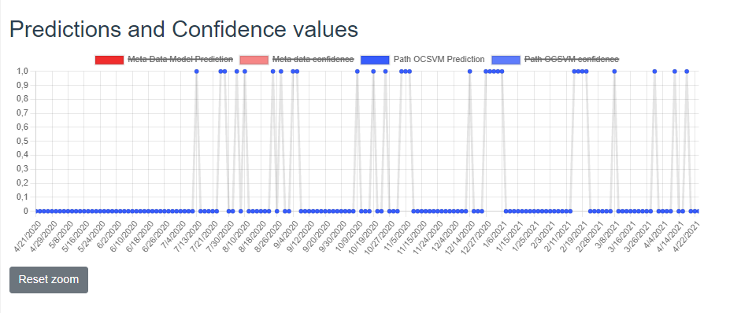
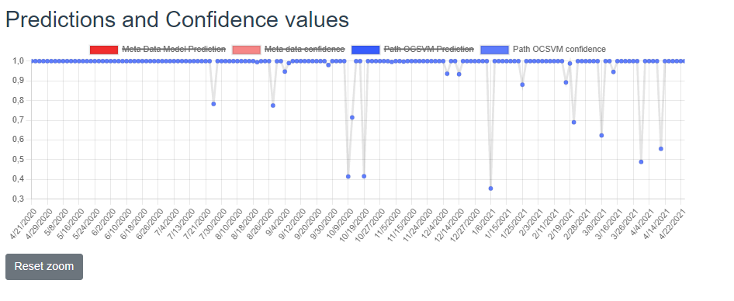
Frontend

Slide 37
Evaluation
File Server Model + Feature Extraction + Continues Training + Integration

Slide 38
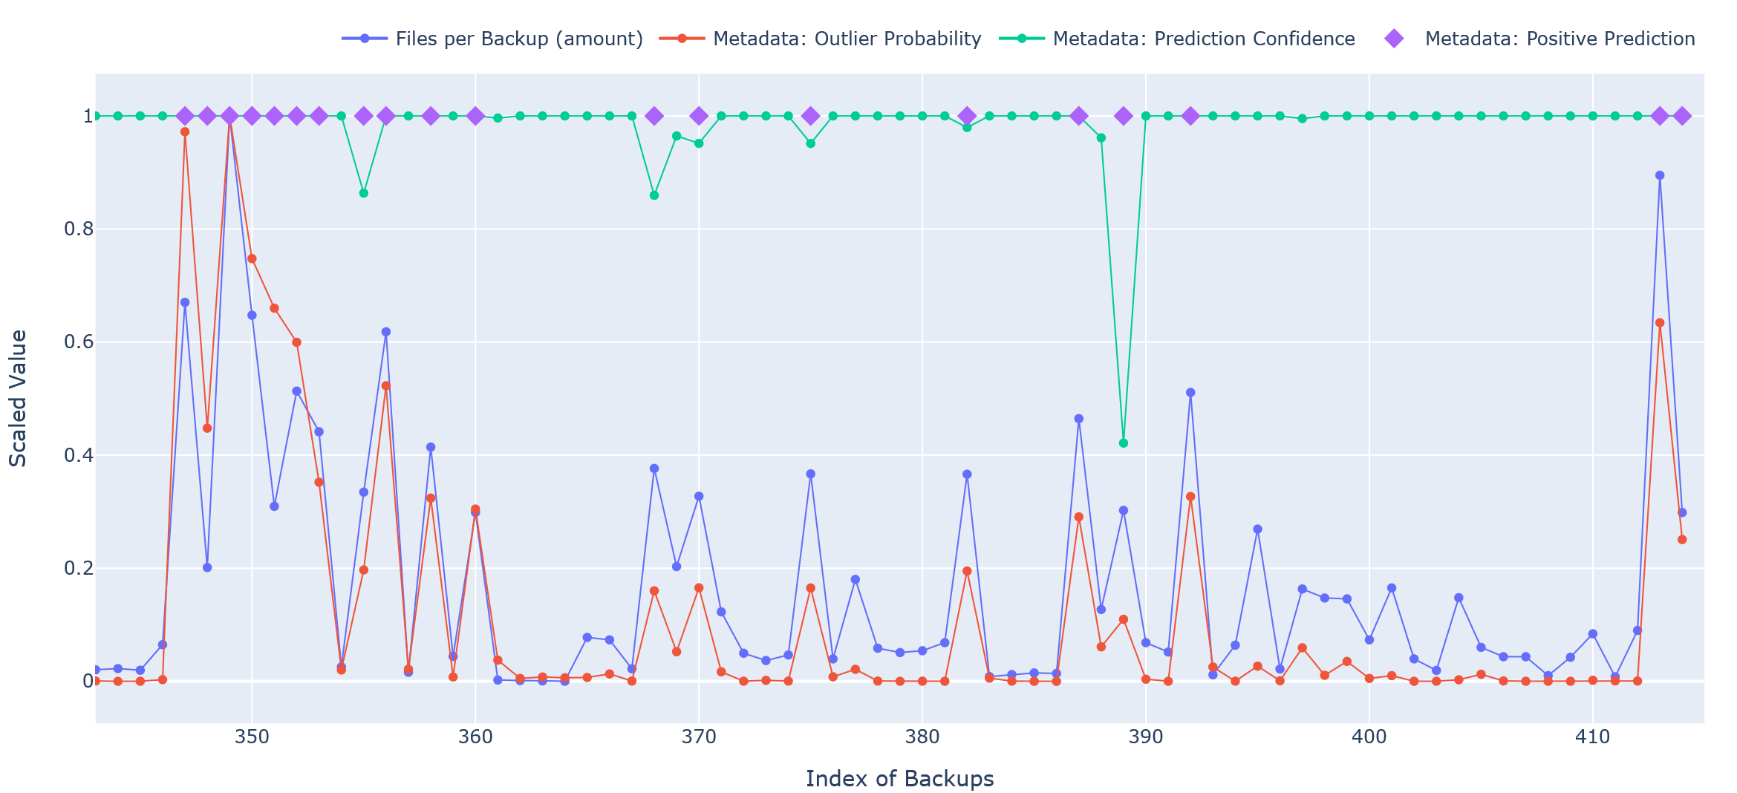
Meta Data Model Results

Slide 39
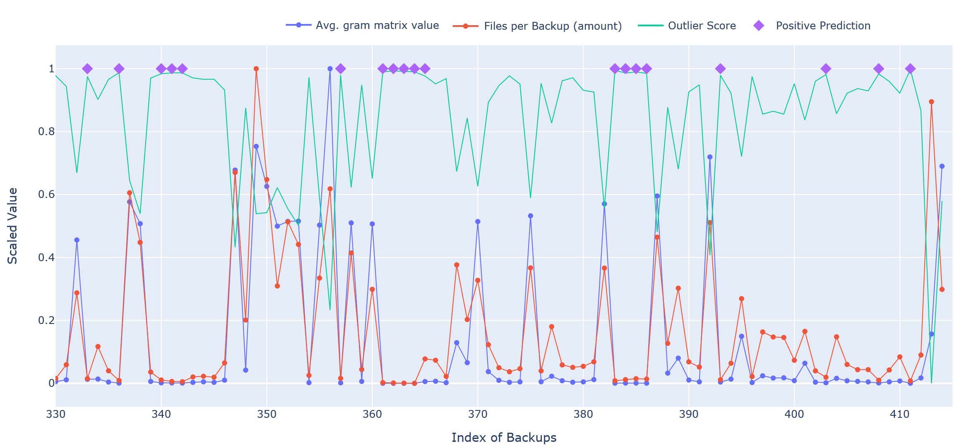
OCSVM – Gram Matrix

Slide 40
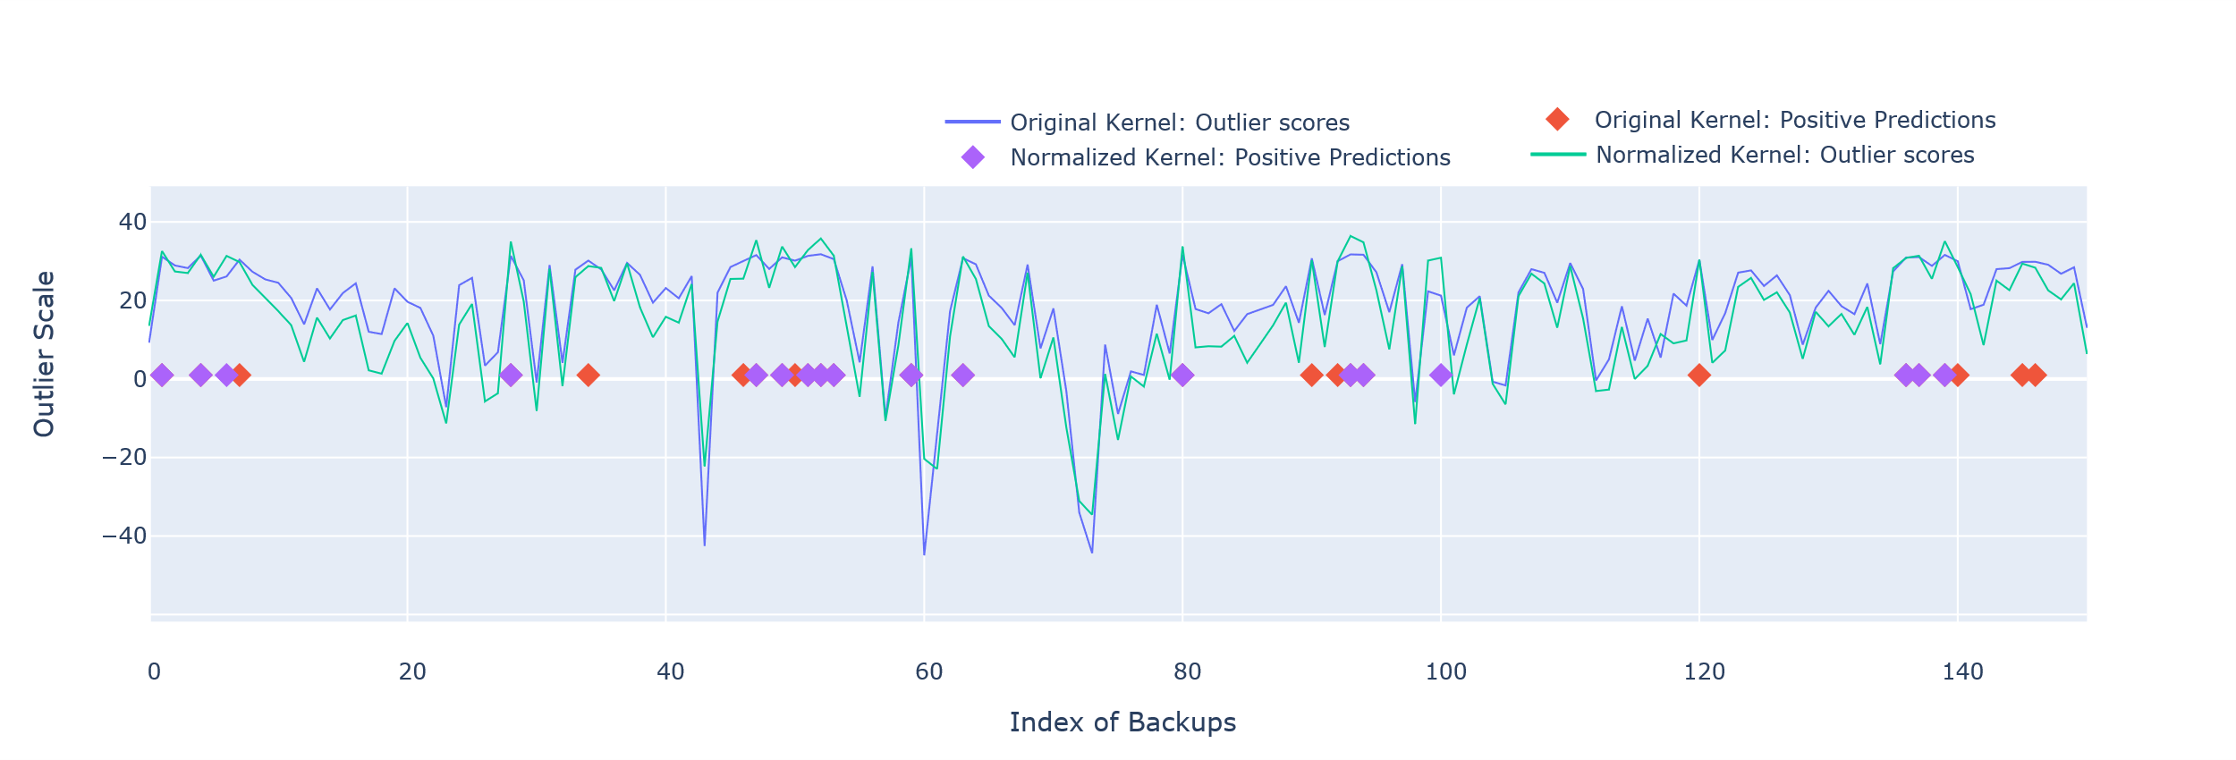
OCSVM Normalization

Slide 41
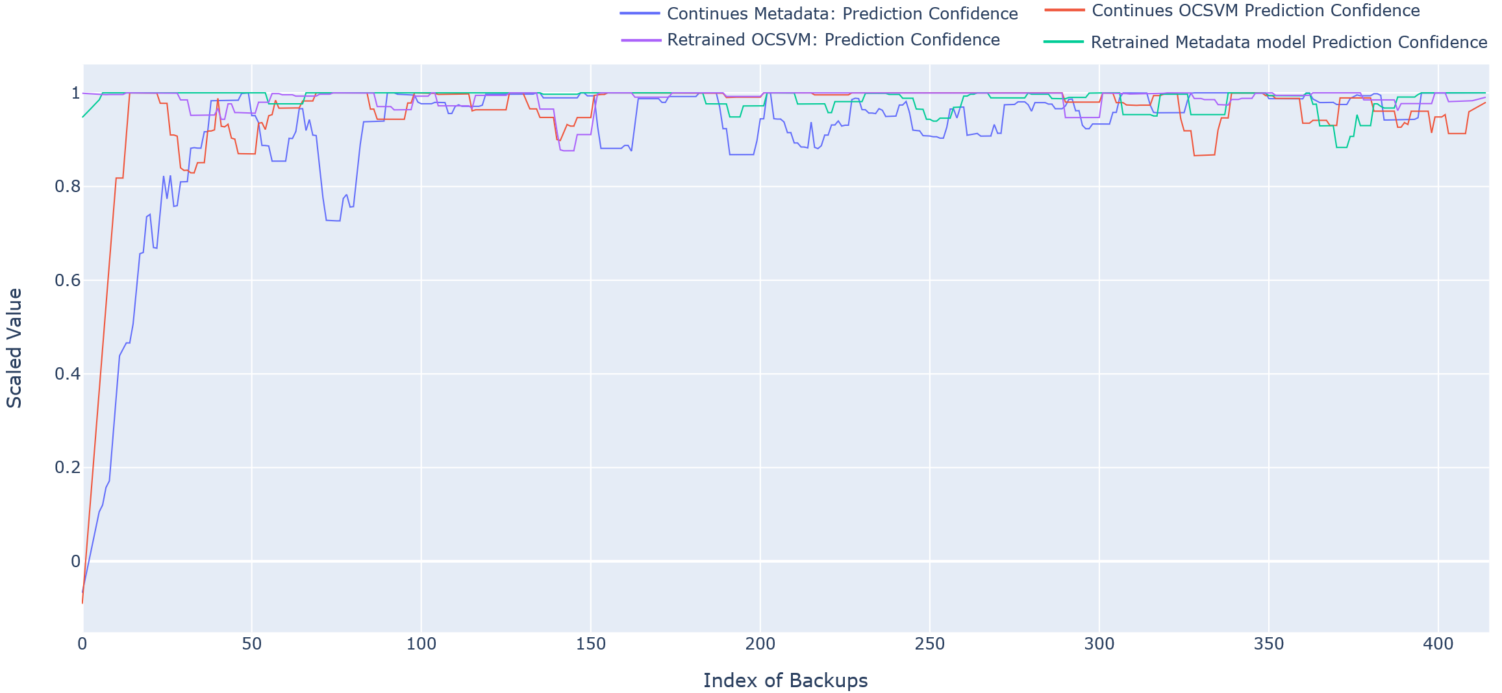
Changing Confidence

Slide 42
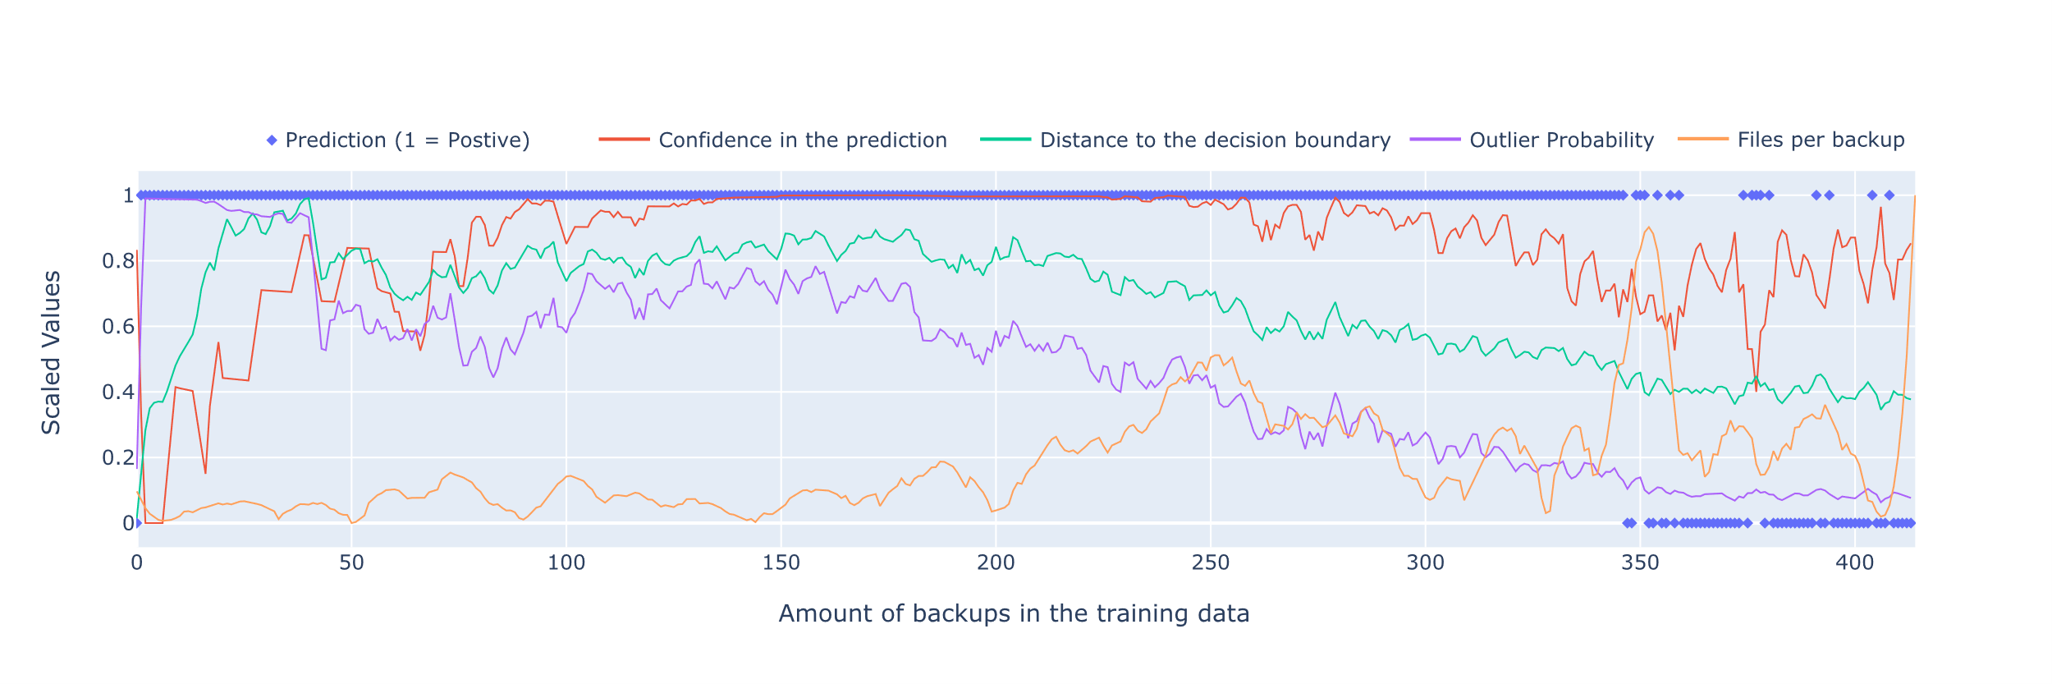

Slide 43
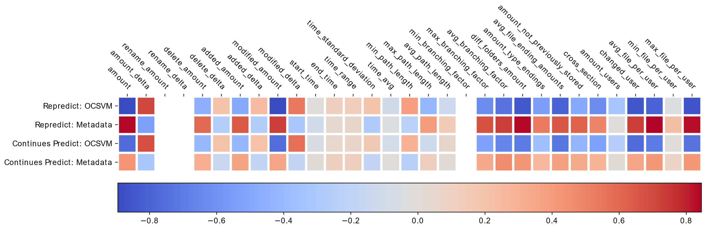
Prediction Corrolation

Slide 44
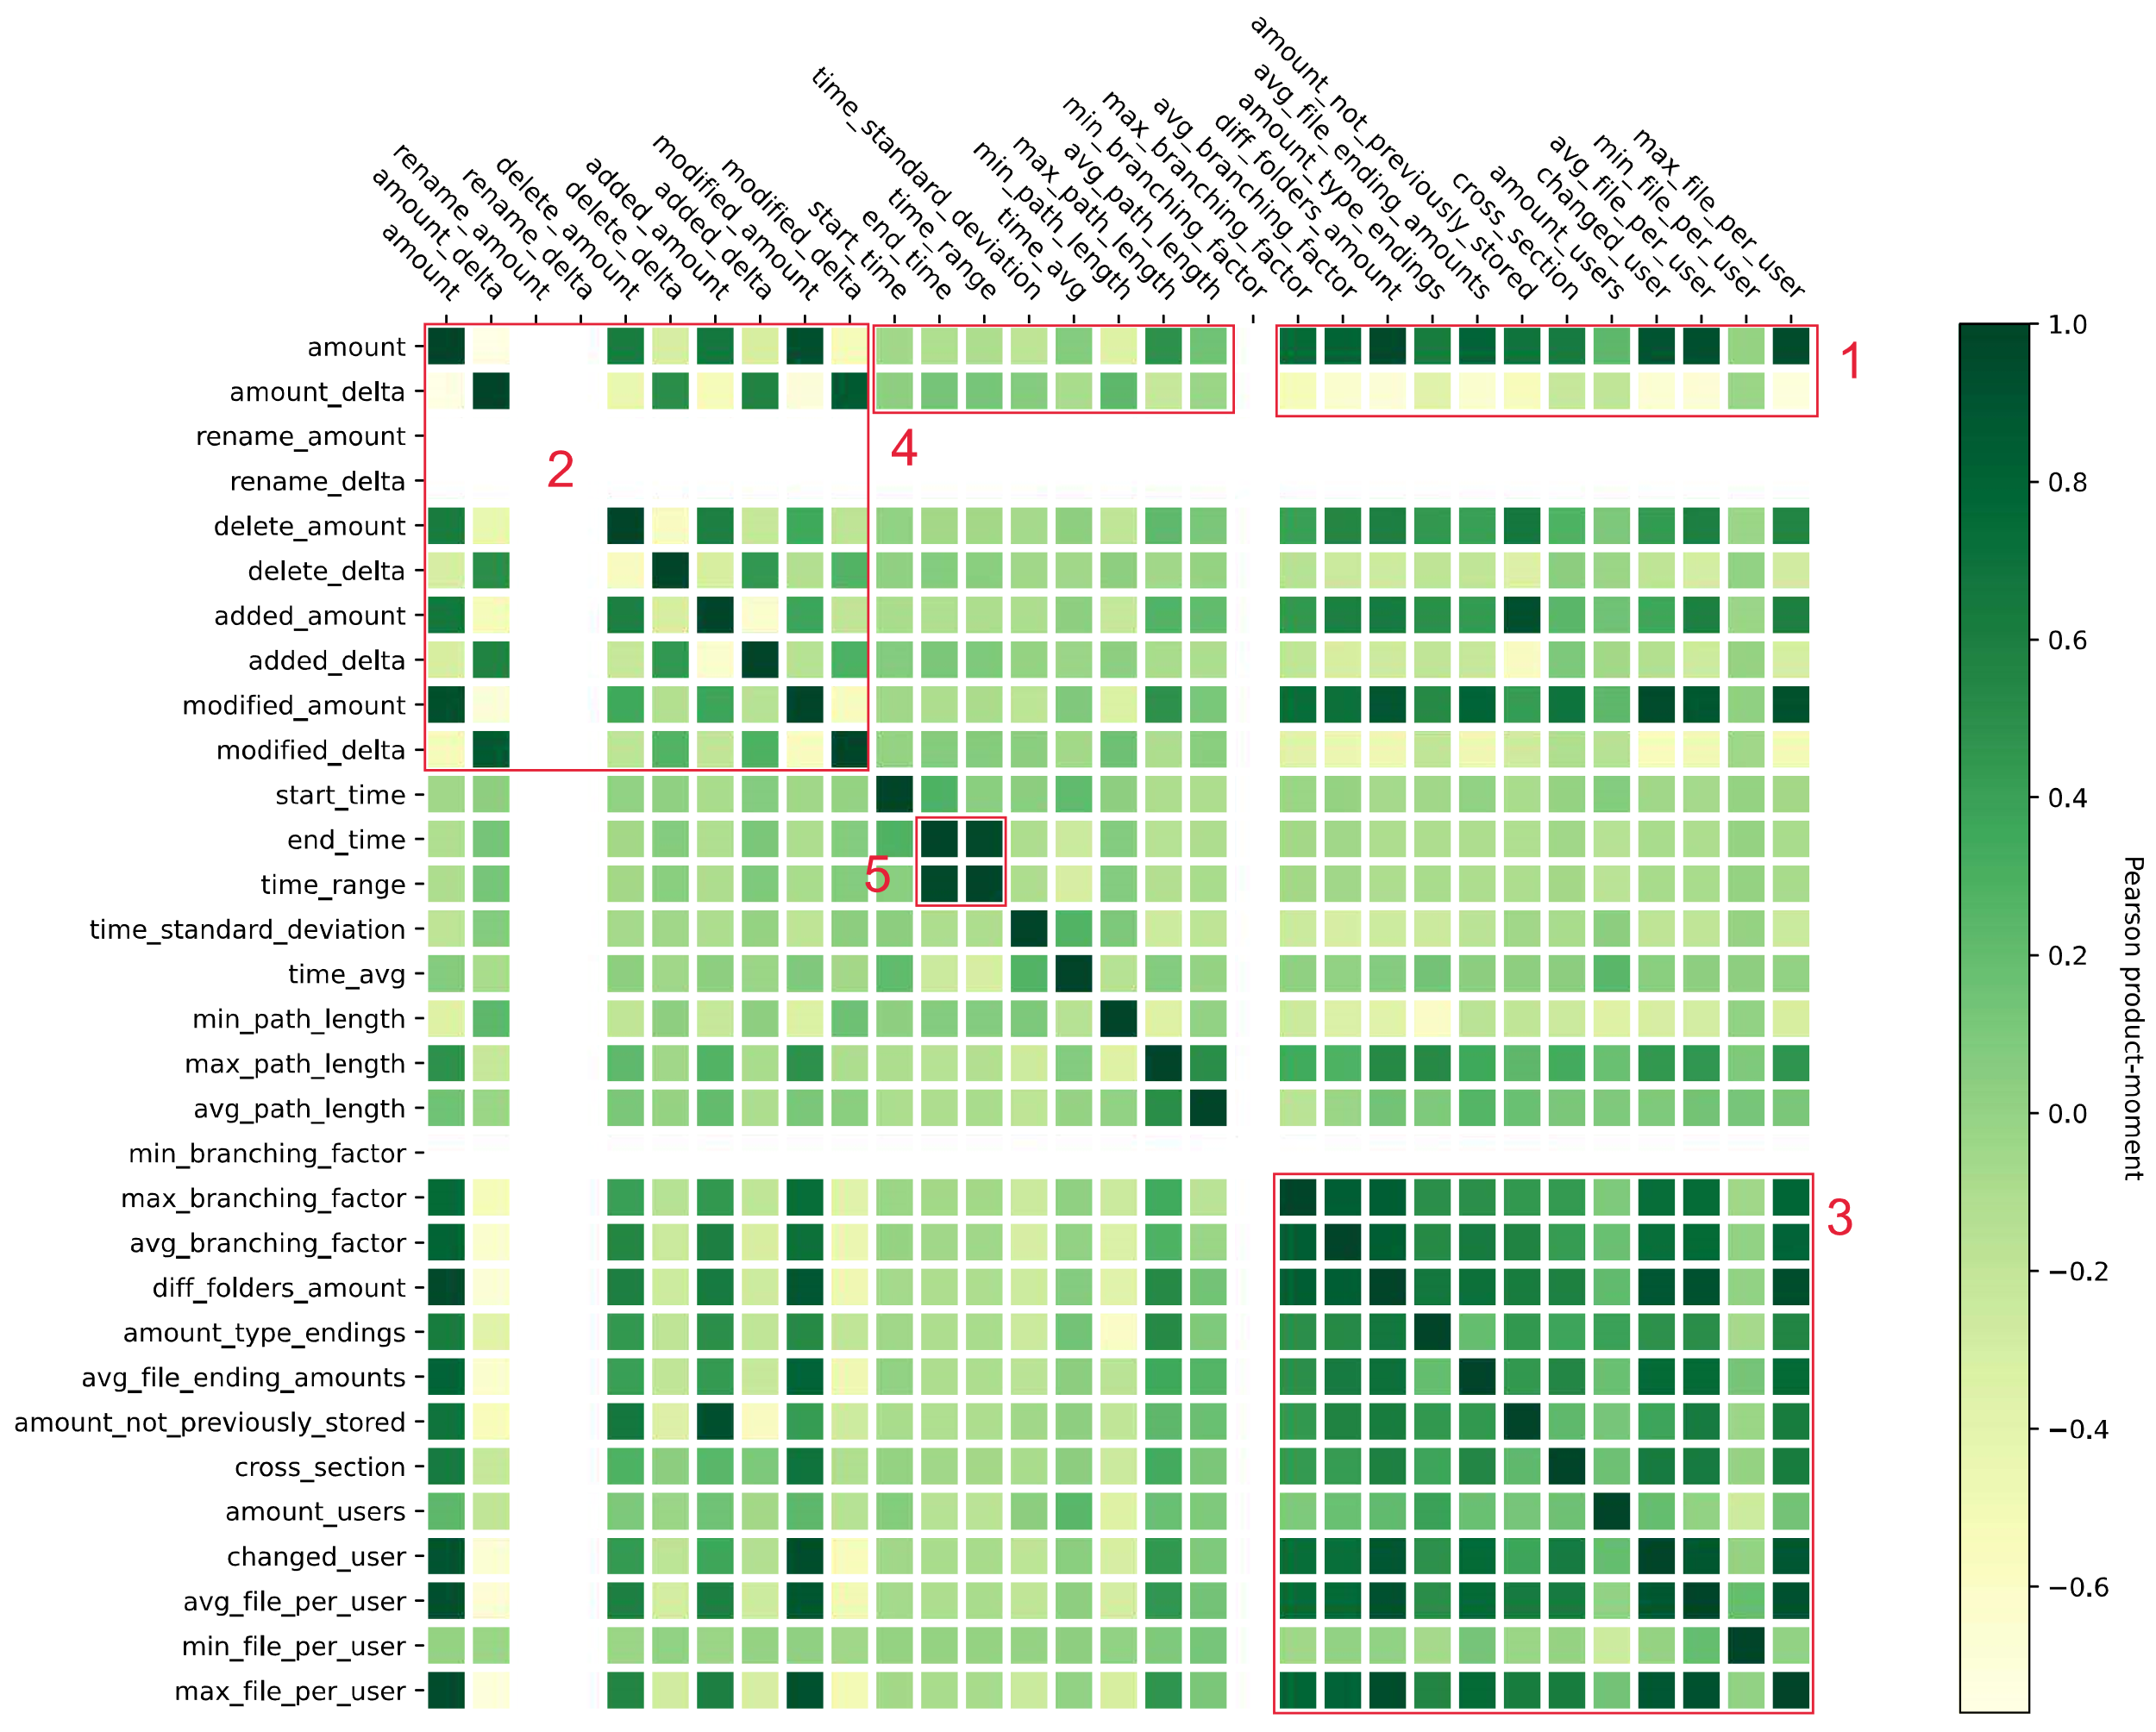
Correlation

Slide 45
Discussion & Conclusion
File Server Model + Feature Extraction + Continues Training + Integration

Slide 46
Thanks for your attention! Questions?

Slide 47
